Slide 1
A Data-Driven Approach to reduce
Non-Moving Inventory (NMI)
“Harnessing Data analytics for Inventory Efficiency”
Bhagirathsinh jadeja

Slide 2
Problem Statement
Problem : The problem statement is related to a consistent increase in non-moving inventory year over year. Currently there are no real-time techniques available to derive classification from SAP.
NMI Predicting : There is need of predictive model to forecast future instance of non-moving inventory resulting from the conversion of slow to non-moving status.

Slide 3
What is NMI
Non-Moving Inventory (NMI) refers to stock items that have not been Consumed or used within a specified period. These are materials that are stagnant in the warehouse or store, tying up capital and space without contributing to revenue generation. In short, NMIs are those items with no turnover.
Importance of Managing NMI for Businesses:
Financial Impact: NMI ties up capital that could be invested elsewhere, impacting the company's cash flow and liquidity.
Storage Costs: Storing non-moving items incurs warehouse costs, further impacting operational expenses.
Obsolete Stock Risk: Over time, NMIs may become obsolete, leading to potential losses and waste.
Guideline: 1. Fast(F) – Items / Materials which have been issued more than 4 Instance per year
2. Slow(S) – Items / Materials which have been issued less than 4 instance per year
3. Non(N) – Items / Materials not issue as all over last 3 years.

Slide 4
Objective of the project
The primary goal of this project is to utilize data analytics techniques to derive Non-Moving inventory and provide actionable insights for effective management.
Key Objective : Identification:
Develop real time NMI classification for identifying different category such as FSN within the existing inventory by ARFA techniques.
Analysis: Conduct a thorough analysis of NMI, examining historical consumption data, purchase patterns, and other relevant metrics.
Root Cause Analysis: Identify the reasons behind the existence of NMI, including overstocking, forecasting errors, or market changes.
Financial Impact Assessment: Quantify the financial impact of NMI on the company's bottom line, considering carrying costs, opportunity costs, and potential losses.
Recommendations: Propose strategies for reducing NMI, optimizing inventory turnover, and improving overall inventory management practices.

Slide 5
Challenges
Traditional System of NMI Classification
Extract the data (SAP) and load in Excel
After extracting data from SAP, utilize a pivot table to filter consumption based movement and
year. Calculating the sum of quantities, subsequently, count the number of transaction material
wise for a comprehensive analysis.
3. Nested if Function:
if([Consumption]> Threshold fast, “Fast”, if ([Consumption] > Threshold_slow,”Slow”, “Non-Moving”)
4. Pivot year wise and considered as F or S by creating new columns
5. After classifying inventory refine the non-moving category by cross- referencing receipt data
(NEW receipt)Within last three years. There might be recent receipt case then re-categorized
as slow moving.
6. Data accuracy is big challenge while working manual with excel.

Slide 6
Challenges
Traditional System Work-Flow
Excel
Complex Formula
Time Consuming
Manual Aggregation
Manual Aggregation
Limitation of
Space
Multiple pivot
Table Creation
Multi filtering with Recent receipt / opening stock

Slide 7
Logics in this project
Consumption
Inventory
Recent Receipt
Focus on Consumption period over the past three years where I count transaction based on Organization Guidelines.
After F& S , Map inventory file to derive “N” (items that haven’t consumed)
Next, I correlate the information with the receipt file and reclassify items from “N” to “S” they have had recent receipt
Opening Stock
Additionally, I incorporate data from the opening file to identify if an item is an opening stock. And if there’s recent receipt, it is reclassified to “N” Again
NMI Prediction (consumption – real time)
NMI Prediction( Real-time data for consumption to be map)) to get the desired result.

Slide 8
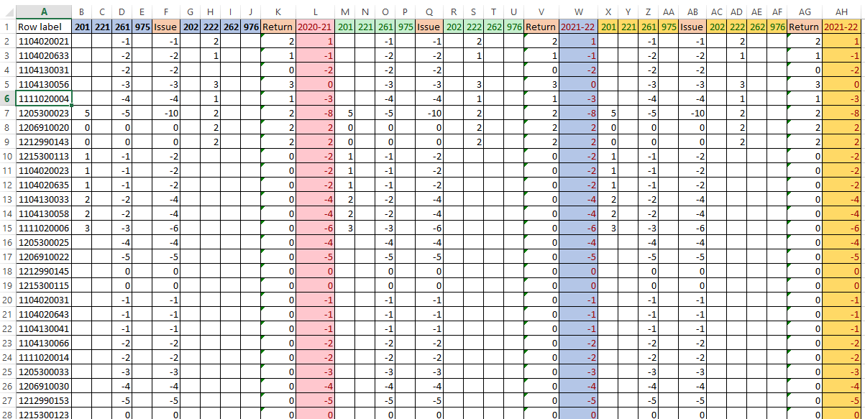
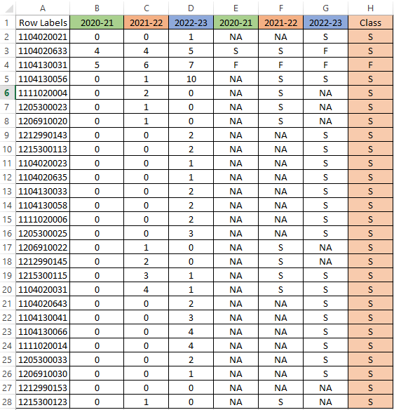
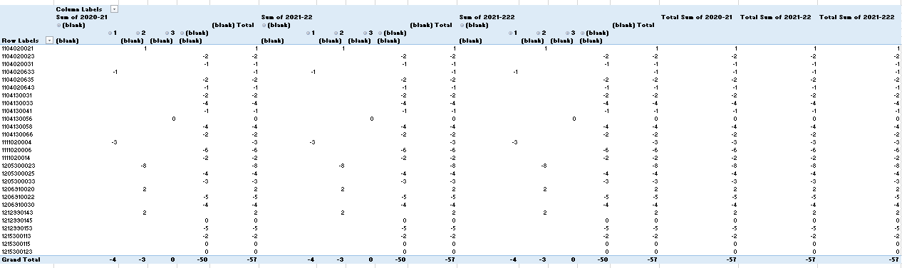
Challenges
Sample Data Traditional System
Year wise filter / Pivot
Year wise classification
Comparison with receipt and opening

Slide 9

Data Driven Technologies

Slide 10
Data Extraction
Consumption
Inventory
Receipt
Opening
MB51 (T-code)
/NMI_CLASS
MB51 (T-code)
/NMI_Rec
ZMB52
(T-code)
/NMI-STOCK
ZMB52
(T-code)
/NMI-STOCK
01.04.2020 to 31.03.2023
01.04.2023
01.04.2020 to 31.03.2023
01.04.2020
For real time solution change data accordingly.

Slide 11
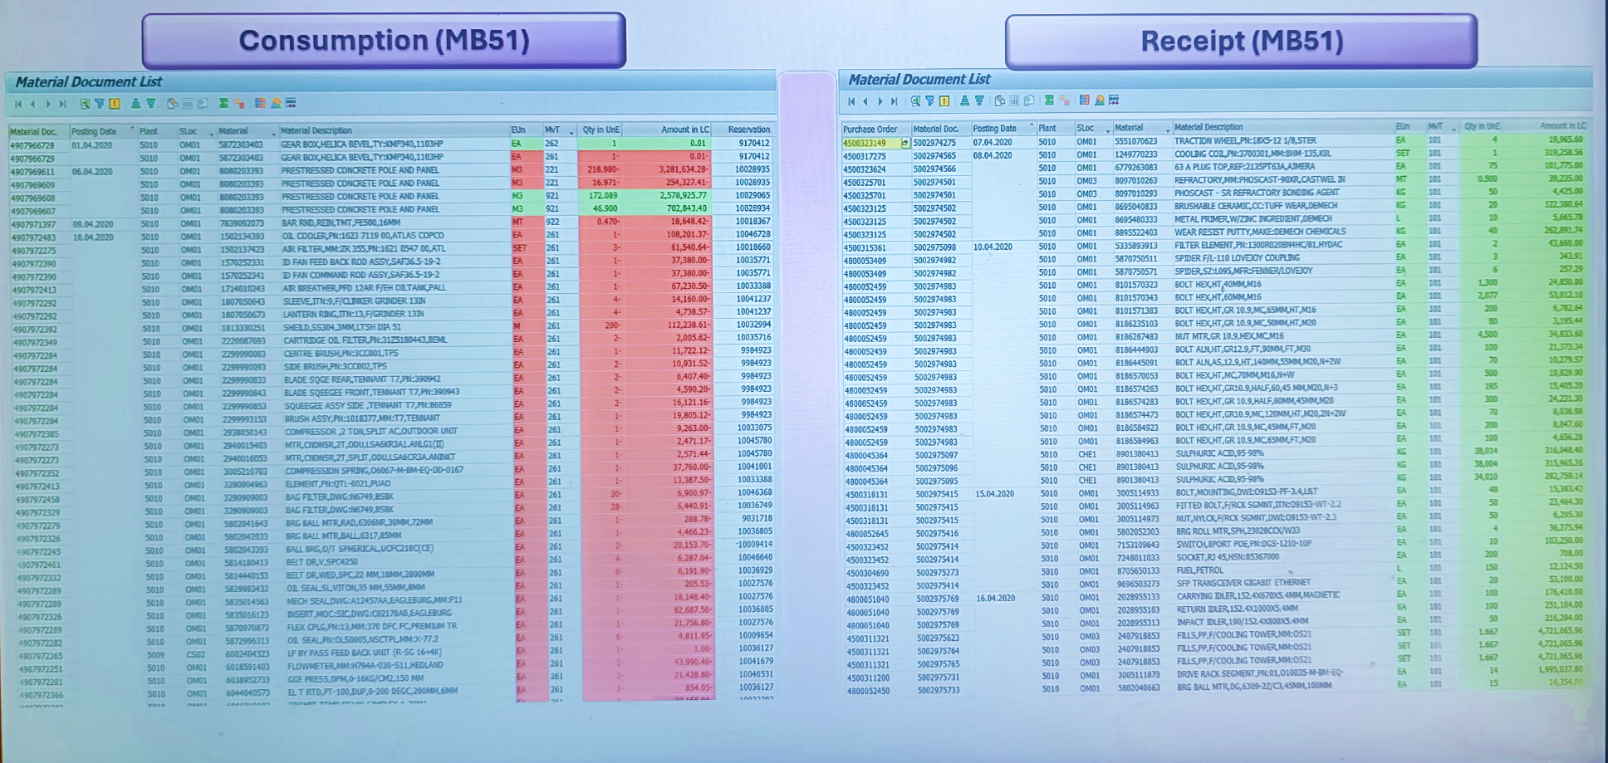
Sample Extraction

Slide 12
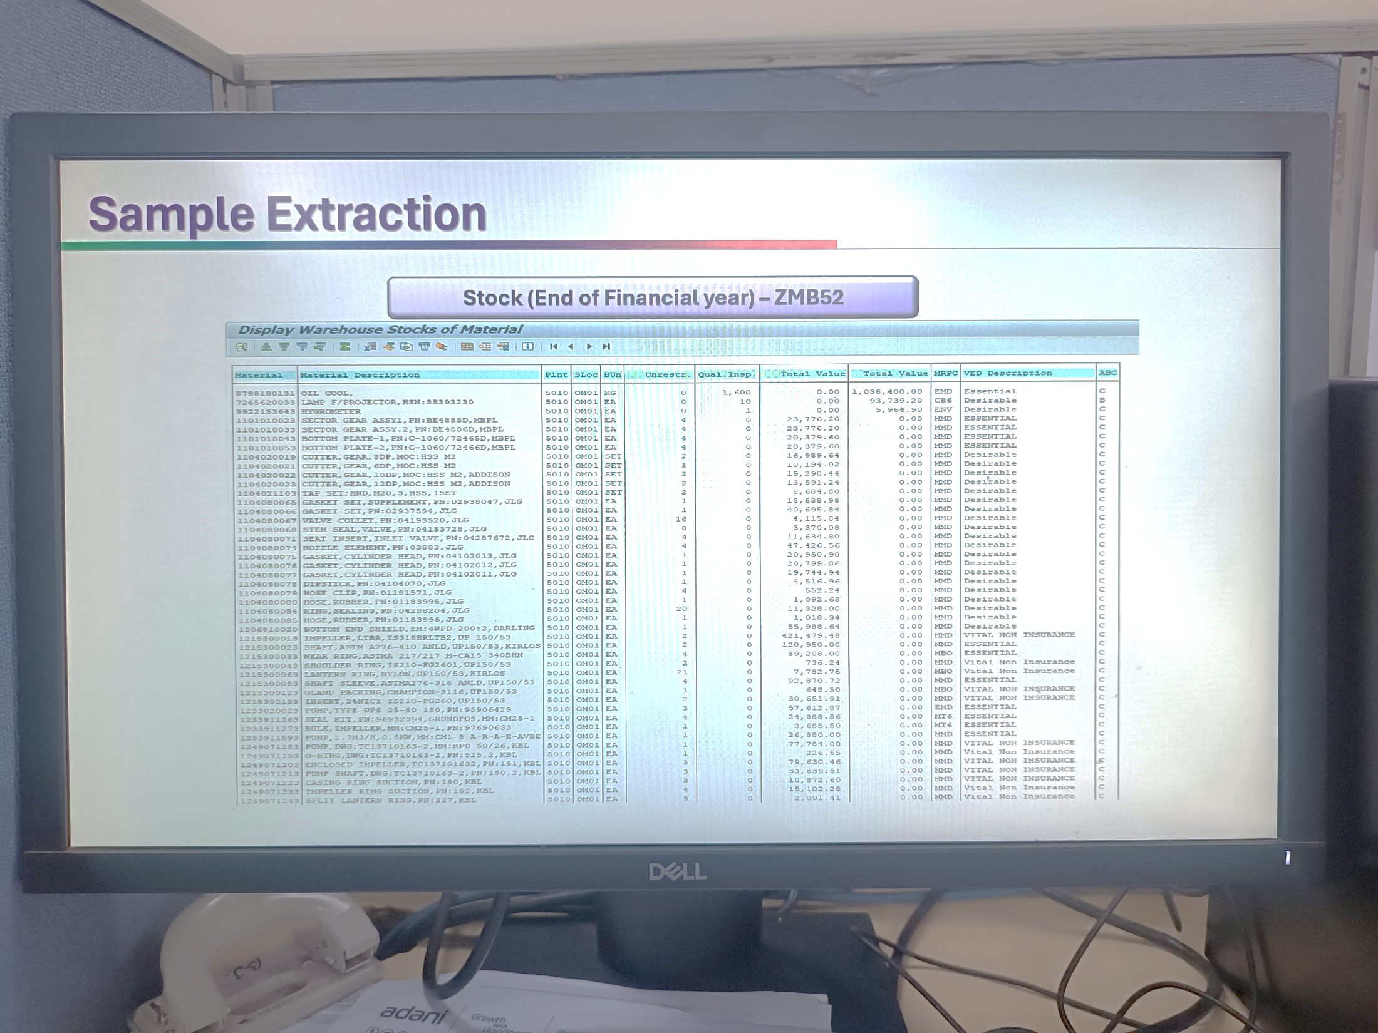
Sample Extraction
Opening Stock (Zmb52)
Closing Stock (Zmb52)

Slide 13
Data Preprocessing
`
01
Cleaning
02
03
04
Remove
Duplicates
Formatting
Checking
Null value

Slide 14
1. Load Consumption file

Slide 15
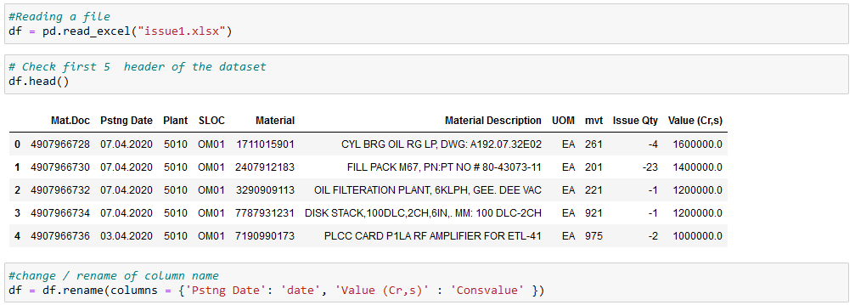
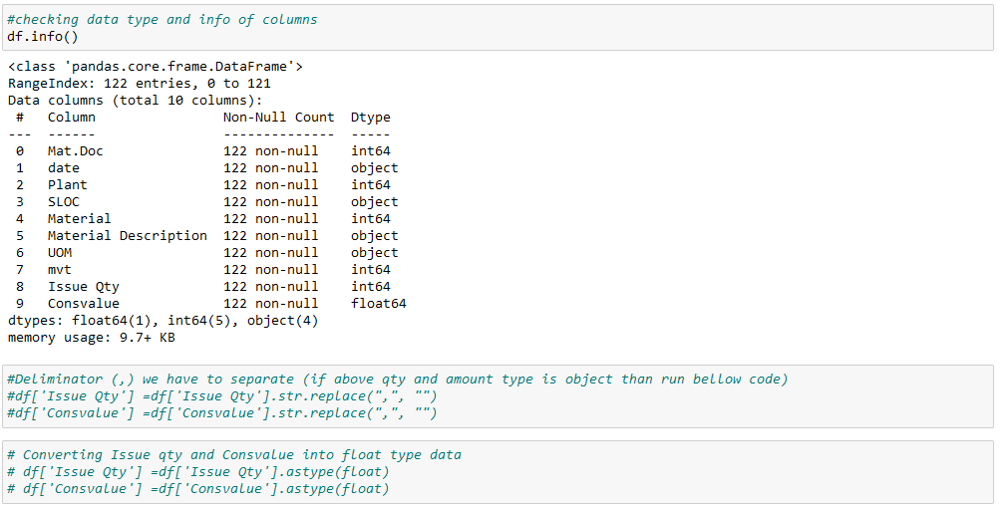
Data Preprocessing
Reading File
Display header
Rename Columns
Checking null values
Formatting
E
D
A

Slide 16
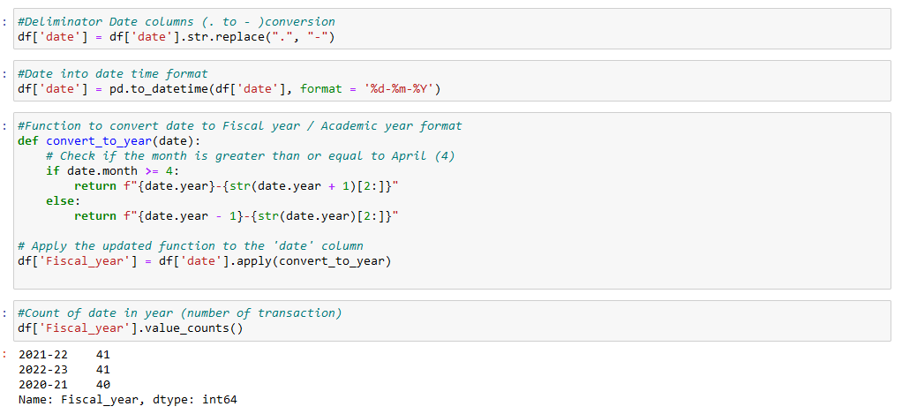
Data Preprocessing
Date format (Dot to Dash)
Datatype Change (object to Date)
DD-MM-YYYY
Date
30.06.2020
30.06.2021
01.05.2022
Year
2020-21
2021-22
2022-23

Slide 17
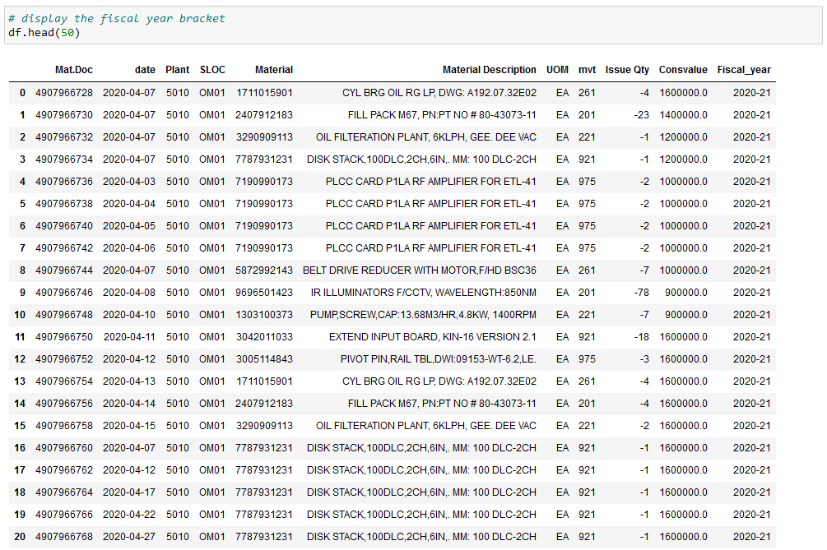
Data Preprocessing
Display after formatting

Slide 18
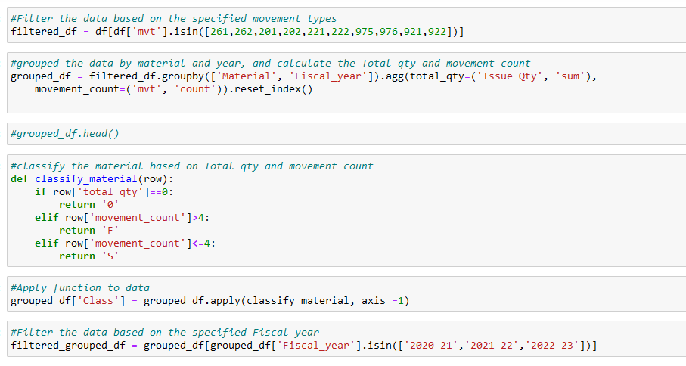
Data Preprocessing
Function
Mapping
Is in Function on
Specified
Movement types
Group data by
Material & year
Sum of Total Qty
And count the
Material.
If Function for
Classification > 4 is F, <=4 is ‘S’ , else 0

Slide 19
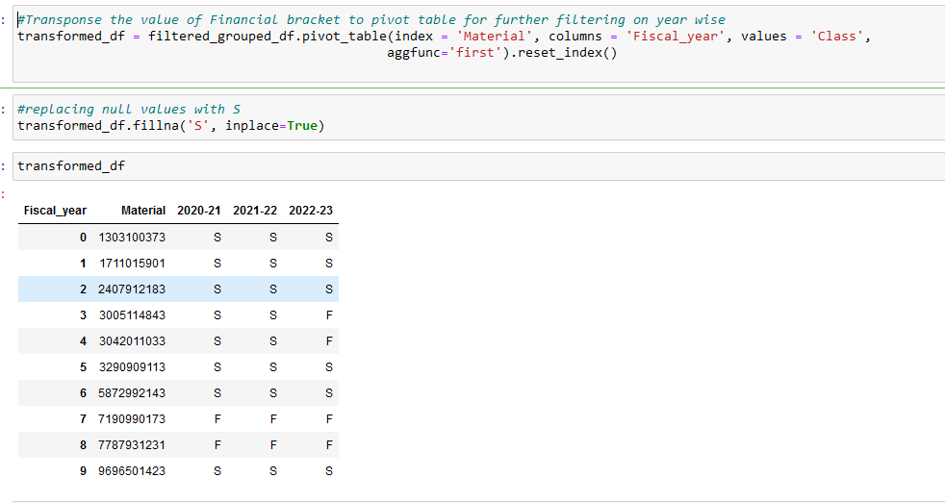
Data Preprocessing
# Group the data by Material and year, and calculate Total Qty. and movement Count pivot Table
The code will give you Data frame (‘transformed_df’) with columns for material, year & count, showing the number of occurrences (or movements) for each material in each year

Slide 20
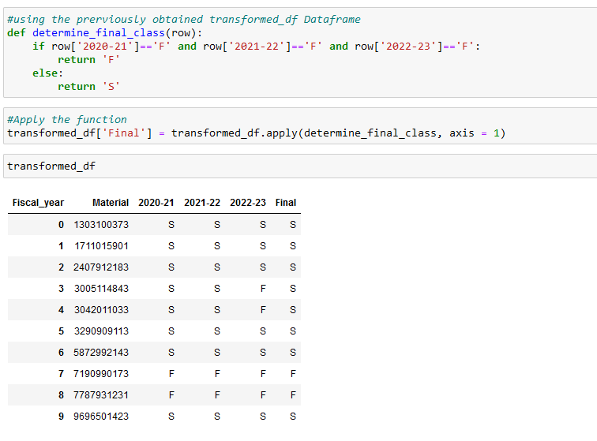
Data Preprocessing
Final Classification
Target Achieved -1st

Slide 21
2. Load Inventory file

Slide 22
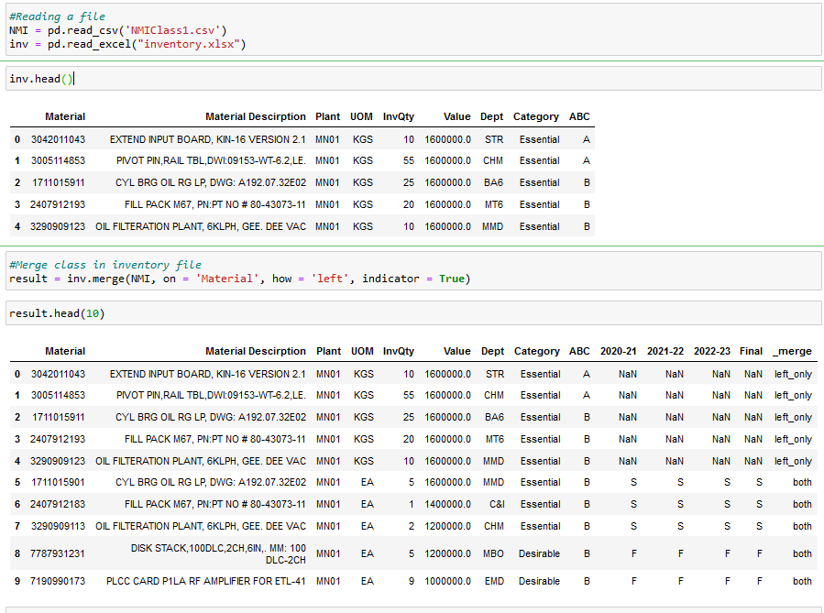
Applying Class to Inventory File
NAN means Not consumed

Slide 23
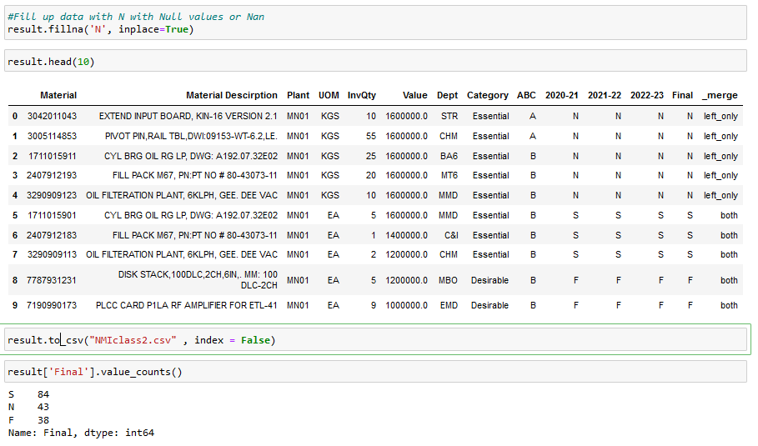
Classification of FSN
Replace NAN to ‘N’ Category

Slide 24
3. Load Receipt file

Slide 25
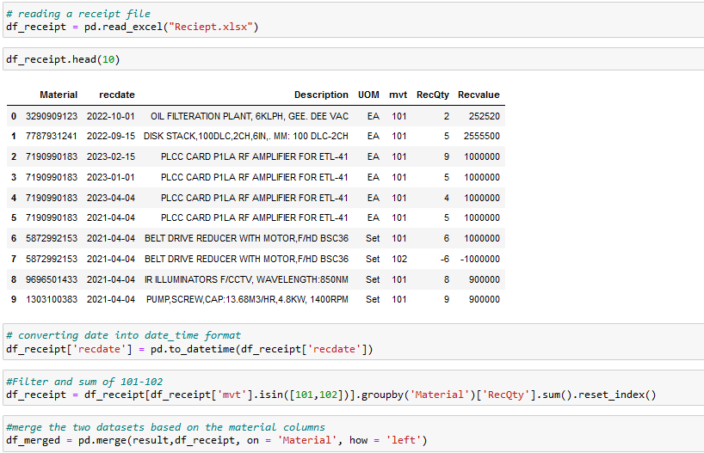
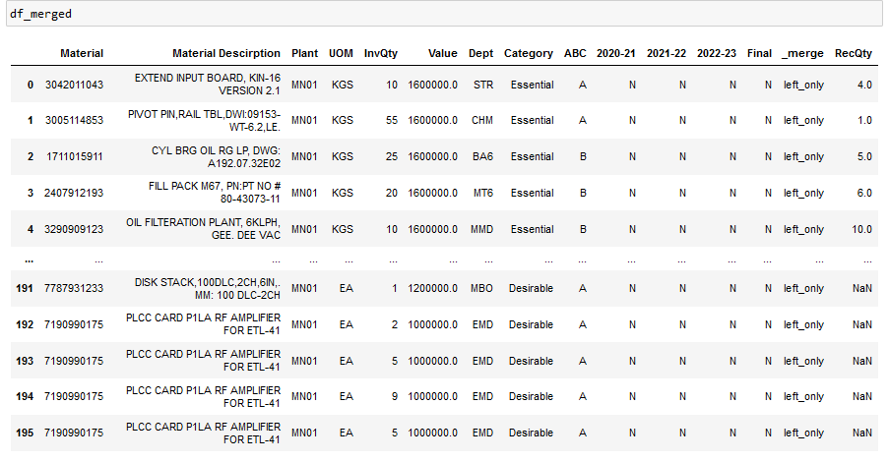
Merge with Receipt
Merge with Receipt Qty. for filtering out real ‘N’ Category.

Slide 26
4. Load Opening file

Slide 27
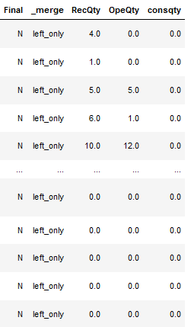
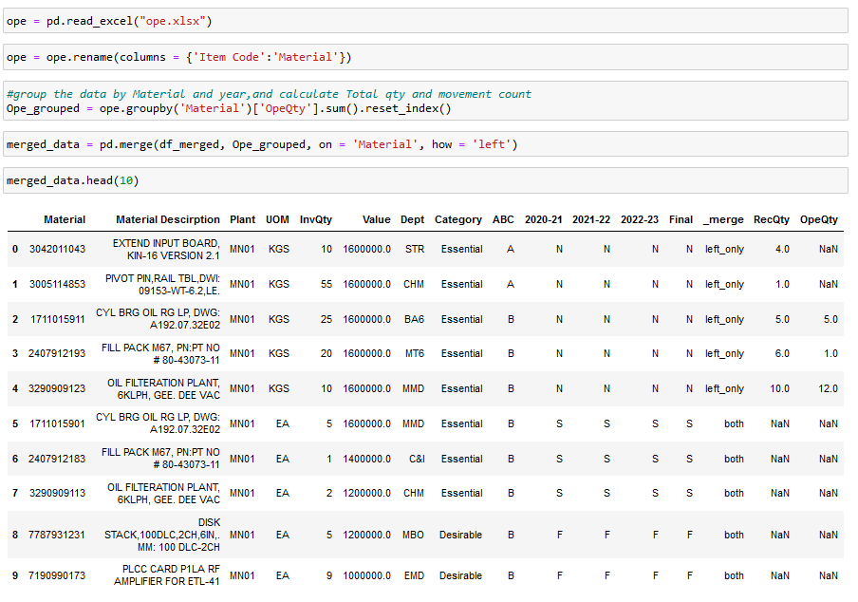
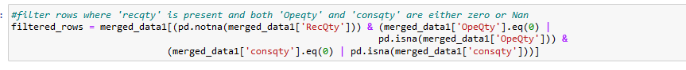
Merge with Opening file
After classifying inventory refine the non-moving category by cross – referencing receipt & Opening data within the last three years. There might be recent receipt case and also Opening Qty. then re-categorized as ‘S’ Or ‘N’ by applying filter.

Slide 28
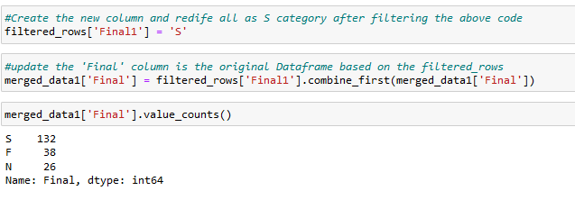
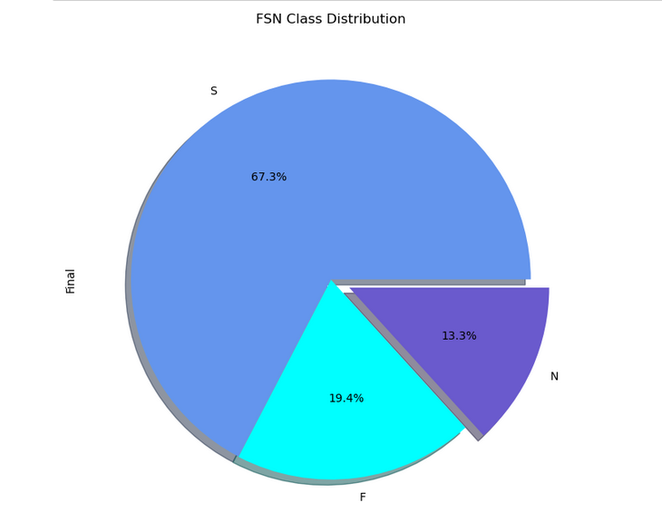
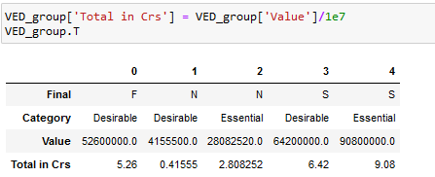
Final Output of FSN
The Crucial task of defining NMI items has been completed now.

Slide 29
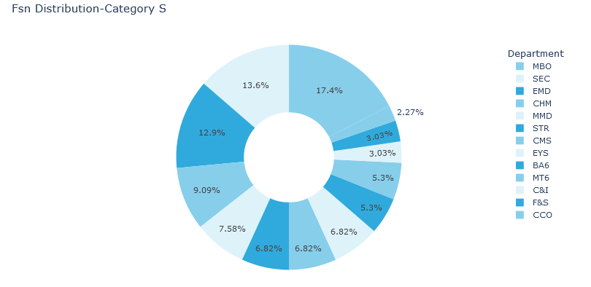
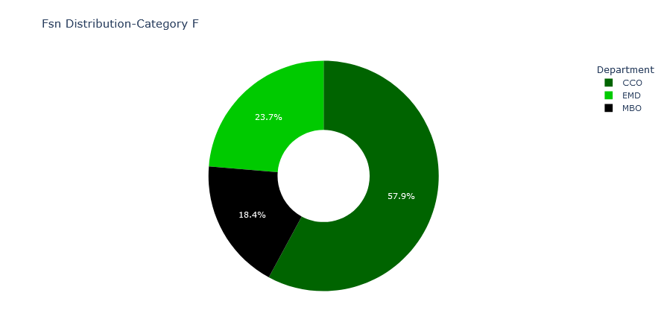
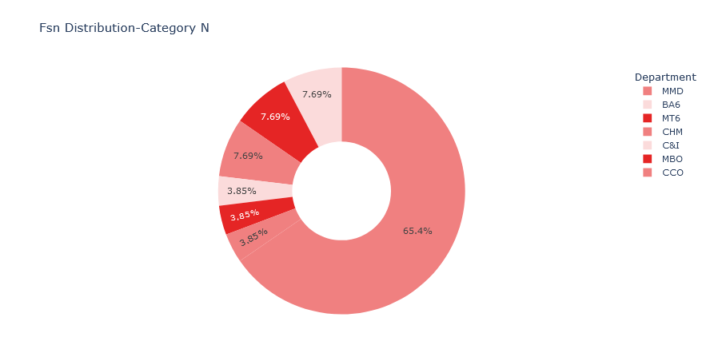
Visualization with Dept.

Slide 30
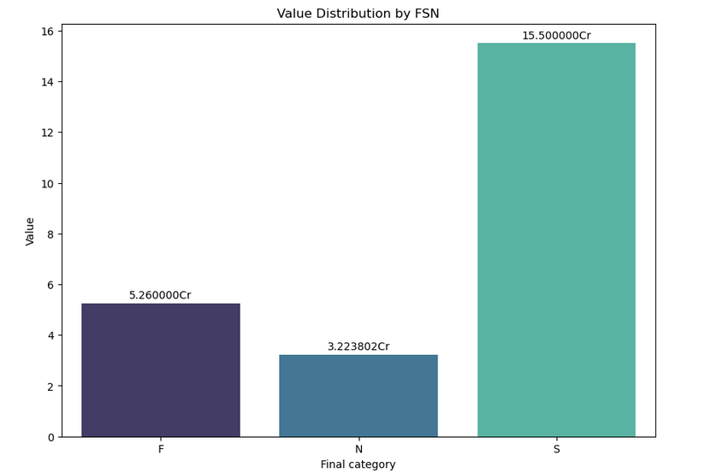
Visualization with FSN

Slide 31

WAY FORWARD
PAST

Slide 32
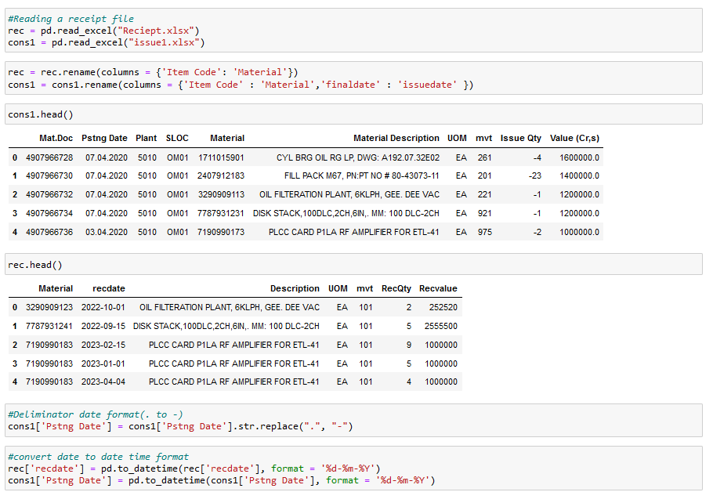
Predicting model for beyond usage
of 730 Days
Reading Receipt /
consumption data

Slide 33
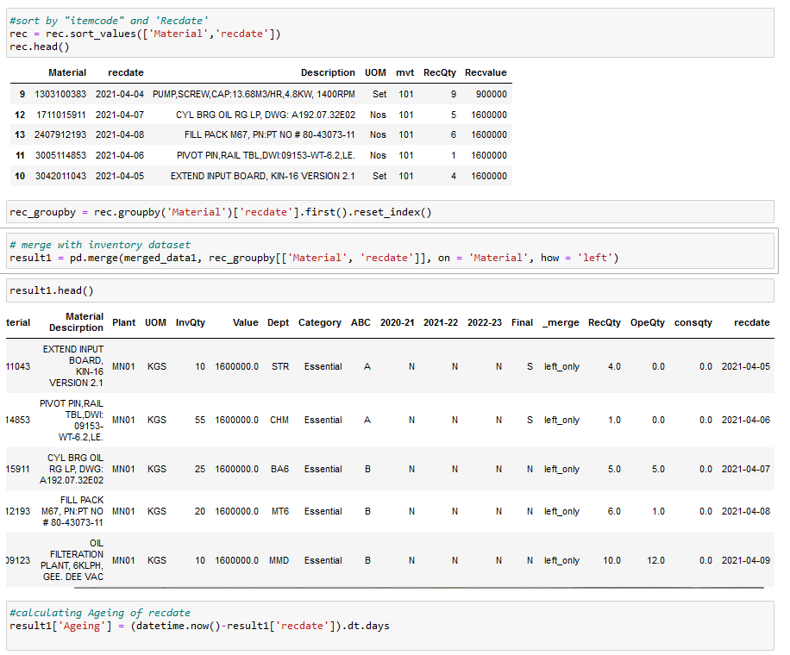
Grouping receipt date

Slide 34
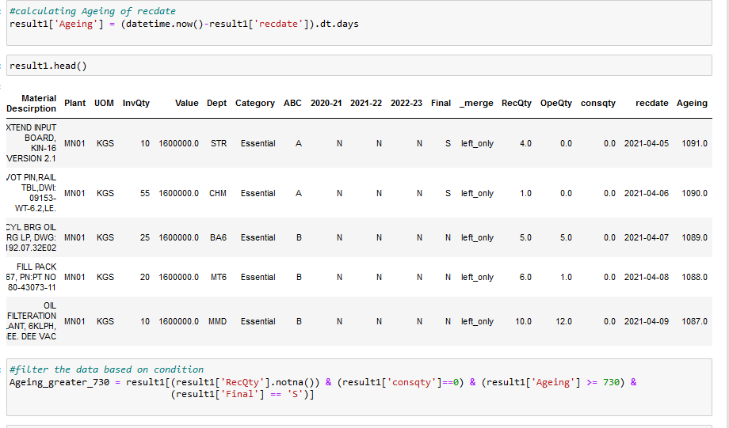
Prediction
Calculating Ageing from todays date
Checking condition if receipt and no issue and final = ‘S’ than display the result

Slide 35
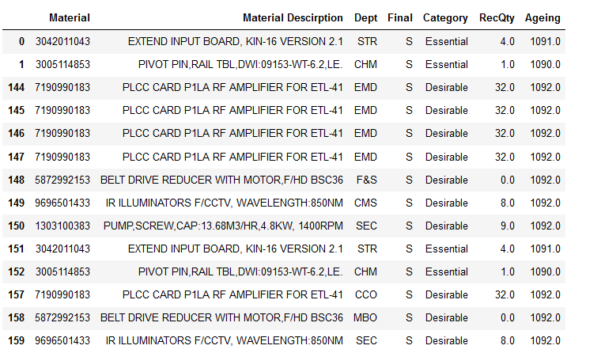
Prediction
NMI Prediction model has demonstrated excellent performance, revealing that 687 Materials, procured over 730 days ago, remain unconsumed, reflecting a substantial value of 1.84 crores.
Output

Slide 36
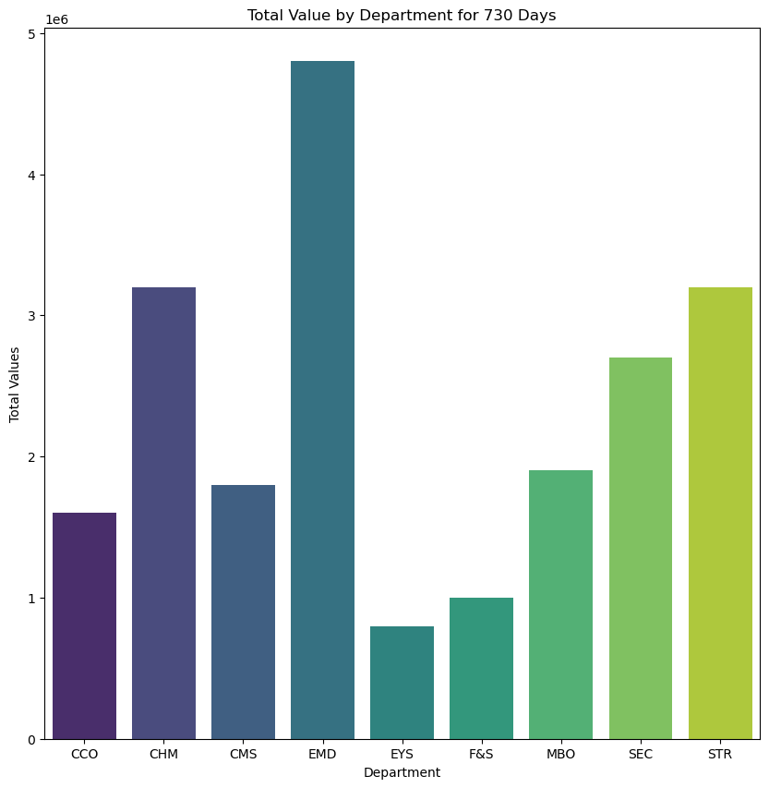
Department wise list

Slide 37
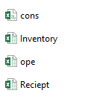


Outcomes
Data
Background
Final
Prediction

Slide 38


Benefits
Proactive Management
Minimized Wastage:
Allow for proactive measure to address and manage potential NMI Inventory before they become a significant concern.
Reduce the risk of product obsolescence and wastage by timely identifying and addressing items likely to transision into NMI
Cost Reduction
Data Driven Strategy:
Enable Cost reduction by preventing excess stock buildup and minimizing storage cost associated with NMI Items
Reinforces the adoption a data driven inventory management strategy, aligning with modern and efficient practices.
NMI
Optimized Inventory Levels:
Avoid Manual intervention:
Facilitates the optimization of inventory levels by strategically addressing items prone to becoming non-moving in advance.
Minimizaes the need for manual intervention, reducting errors and ensuring a more automated and accurate prediction process.
Enhanced Decision Making:
Time Saving
Empowers decision-makers helpful insights, helping them make smarter choices about how to stock inventory and manage it effectively.
Saves times by automating the prediction process, allowing teams to focus on strategic than manual data handling.

Slide 39


